Slide 1
Engaging communities in the response to COVID-19
Webinar by Sonar-Global
June, 15 2020

Slide 2
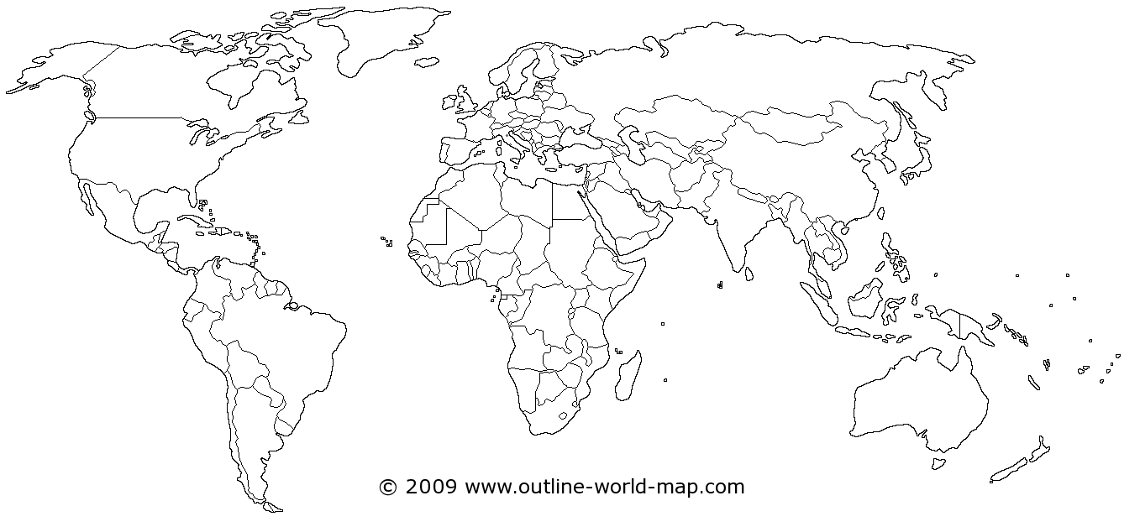
What is Sonar-Global?
European funded project (3 years, 2019-2021)
Building a sustainable global network to mobilize the social sciences against Infectious threats (outbreaks, antimicrobial resistance and vaccine hesitancy)

Slide 3
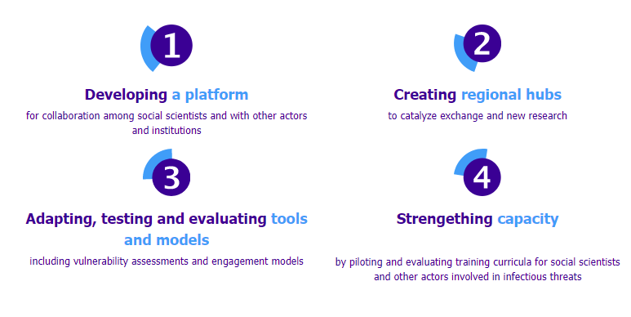
What is Sonar-global doing?

Slide 4
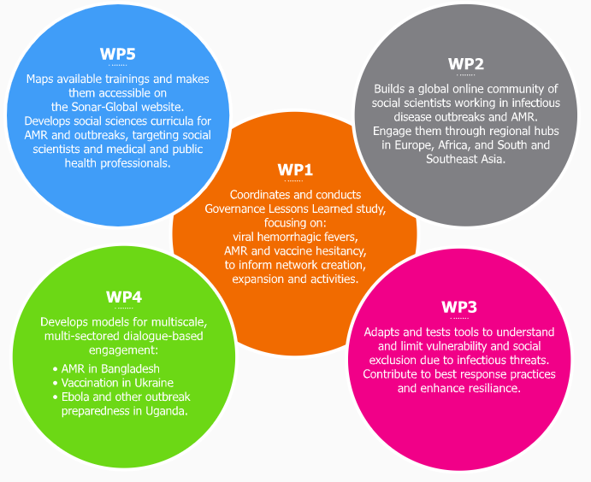
Sonar-global activities

Slide 5


Slide 6

Challenges in Community Engagement during Covid-19
Ruth Kutalek,
Medical University of Vienna
SONAR global Webinar| June 15th 2020

Slide 7
Principles of Community Engagement
Central idea – How can communities be better involved in Covid-19 response (or any health crisis)?
How are communities defined? Context specific: Urban-rural contexts, social groups, civil society (the “public”), settlements, villages
Achieving better results in emergency response, e.g.:
  “social” distancing, isolation & quarantine
  contact tracing
  unpopular measures, low compliance: innovative solutions
Community participation: e.g. volunteering, checking on neigbours et.
Co-production of health

Slide 8
Principles of Community Engagement
Participatory
Dialogue with affected groups instead of top-down communication
Multi-level (micro-macro) and multi-sectoral (all fields of life) engagement
How can existing resources be used? (producing protective equipment, home care)
What do communities want, what do they need? (short-term, long-term, in preparing for another crisis)
CE is essential to work against discrimination and stigmatization
Many examples from past outbreaks

Slide 9
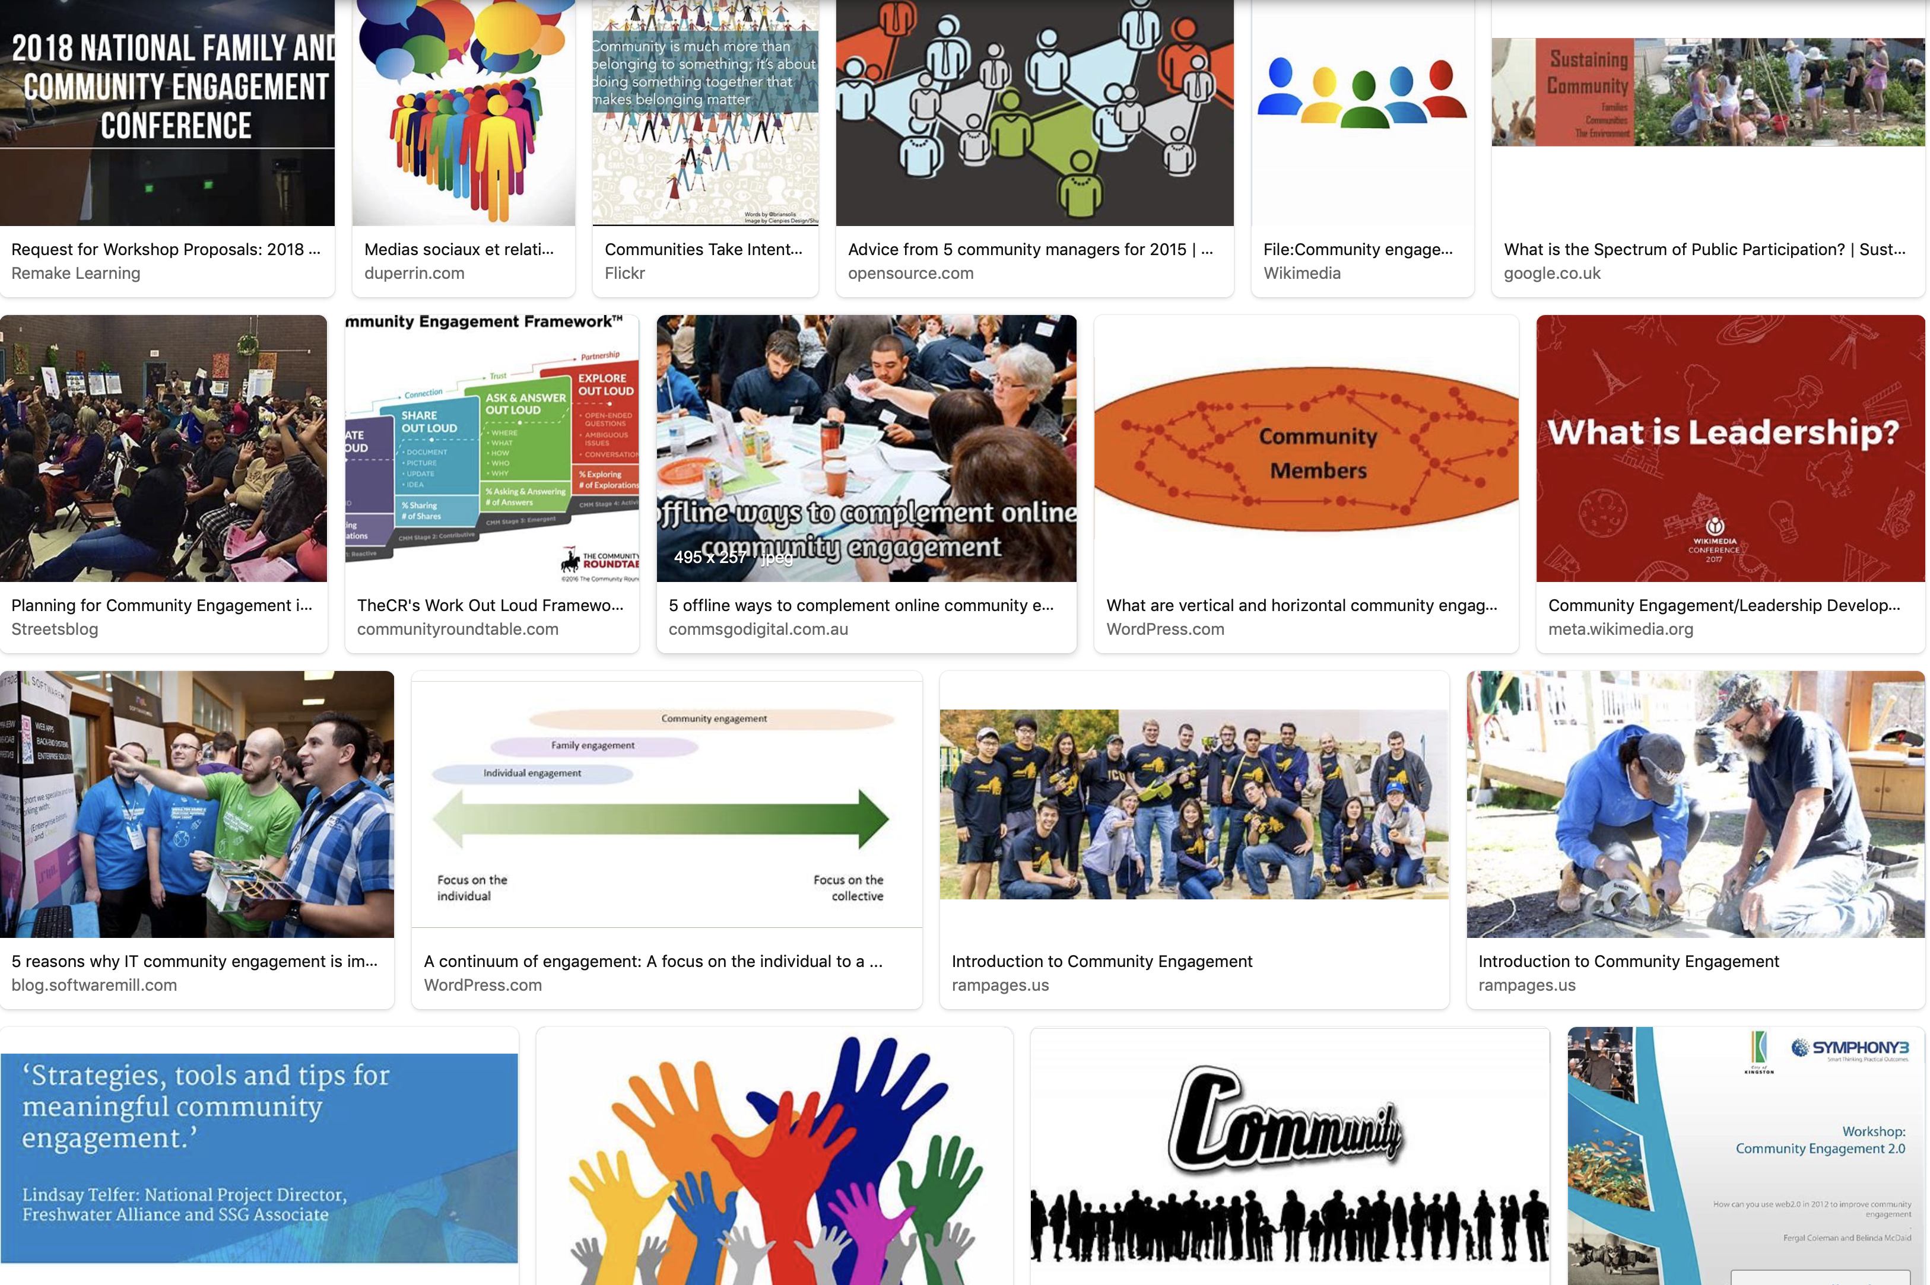

Slide 10
Challenges of Community Engagement
Participation of communities during Covid-19 when there is lock-down, when movement is restricted, when certain groups are physically isolated, have no access to reliable internet
Engagement of communities in light of massive inequalities in health care (e.g. lack of social insurance)

Slide 11
Challenges of Community Engagement
Identification of and outreach to vulnerable groups
  Elderly (physically vulnerable, isolation in care homes, little access to online resources, possible re-traumatization because of war-time experiences)
  Women (gender based violence, single mothers, exposure through care work)
  Young male refugees and asylum seekers (exposure seasonal work)
  Homeless people

Slide 12
Co-production in emergency response
Sustainable and inclusive participation, e.g. fund community engagement taskforces
Create (virtual) spaces for interaction, reach out to communities, include their views (front-line responders, marginalized)
Make sure voices are heard, policy responses address concerns
(Marston et al. 2020)

Slide 13


Public consultations in Ukraine and their role in COVID-19 response
Oksana Koshalko
15 June 2020
| June 2020

Slide 14
Methods and objectives of satisfaction survey on public consultation system for draft orders, Ukraine, 2020
.
The aim - to collect opinions of public consultations participants about their experience of participation in public consultations system (PC system) for draft orders and propose recommendations to improve the PC system.
The objective - to know about satisfaction of public with PC system and find ways to make involving the public in PC system more effective.
We asked socially and politically active citizens which are members of 2 local community organizations in Kyiv (people of different professions - doctors, social science experts and others) using the online questionnaire.
Questions were about their experience participating in the PC system (comment regulations, areas, types of public consultations events, feedback after participation).
| June 2020

Slide 15
Results of satisfaction survey on PC-system
| June 2020

Slide 16
Respondents who commented legislative documents, n=27
26 (96%) indicated areas of legislative documents they commented:
  6 (23%) commented public health documents
  3 (11%) - health care documents
  3 (11%) - both types documents (health care and public health)
  2 (7%) - social science and public sector documents
  2 (7%) - health care, public health, public sector
  10 (37%) - epidemiology and public health documents
20 (74%) indicated whether their suggestions were considered
  12 (60%) their comments and suggestions were not taken into account when the regulations came into force
  7 (35%) indicated that their comments and suggestions were taken into account partially
  1 (5%) indicated that comments and suggestions were taken into account when the regulations came into force
| June 2020

Slide 17
Types of public consultations events in which respondents participated, n=42
6 (14%)
surveys and completed questionnaires
3 (17%)
focus groups
2 (4%)
work of state bodies (meetings, collegiums, seminars, conferences, etc.)
2 (4%)
3 (17%)
professional discussions
Other (surveys, completed questionnaires, participated in the work of state bodies (meetings, collegiums, seminars, conferences, etc.)
26 (61,9%)
Indicated other types of public consultation events
| June 2020

Slide 18
Respondents who commented legislative documents, n=27
 | Suggestions from respondents:
22 (46%) | organize broader discussions at round tables, meetings, focus groups with visual contact between the authors of the acts and members of the public.
15 (31%) | announce public discussion more broadly (television, social networks, radio).
8 (17%) | hold discussions in professional circles without public participation.
2 (4%) | pointed out that the model is working fine, no improvements are required.
| June 2020

Slide 19
Conclusions
Most of the participants are people working in the areas of health, public health and social sciences and have long-term professional experience in the fields of activity.
Participants commenting on draft orders mainly several times and most often, participants commented on draft orders related to public health, health care and the public sector.
Most often, respondents took part in public events as polls, filling out questionnaires, participating in focus groups and professional discussions.
Majority of respondents indicated that they never received feedback after submitting a public comment and noted that their comments and suggestions were not considered or were partially accepted.
The most frequent suggestion is to expand communication between order developers and members of the community and to broader announcements of public discussions on social networks and television.
| June 2020

Slide 20
Recommendations
.
publish announcements on various channels including the press and social networks to increase the number of people who can contribute
establish feedback with participants and provide them with reason of refusal comments and suggestions
expanding communication between order developers and members of society organizing wider discussions with visual contact between the authors of the draft orders and members of the public using face-to-face meetings (round table as example) or online meetings
| June 2020

Slide 21
Public consultations and COVID-19 response in Ukraine
.
Participation of representatives of different types of business in consultations on quarantine lifting conditions
Meetings and consultations of representatives of communities near Verkhovna rada and Cabinet of Ministries
Meetings of representatives of public transportation association with deputy minister of Health regarding the conditions of public transportation when quarantine is lifting
| June 2020

Slide 22
Public consultations and COVID-19 response in Ukraine
.
Meetings of representatives of different businesses with deputy Minister of health:
- transportation
- underground transportation (metro)
- hotel business
- dentists
- restaurant business
- football federation
- religion organizations
| June 2020

Slide 23
Public consultations and COVID-19 response in Ukraine
.
Drafts of 15 regulations on quarantine lifting conditions were published on MOH website
More than 1100 feedbacks were received during 4-5 days. Most of them had similar content and were taken to account and included into final documents. Every draft were added with 2-3 significant statements marked in feedbacks
| June 2020

Slide 24


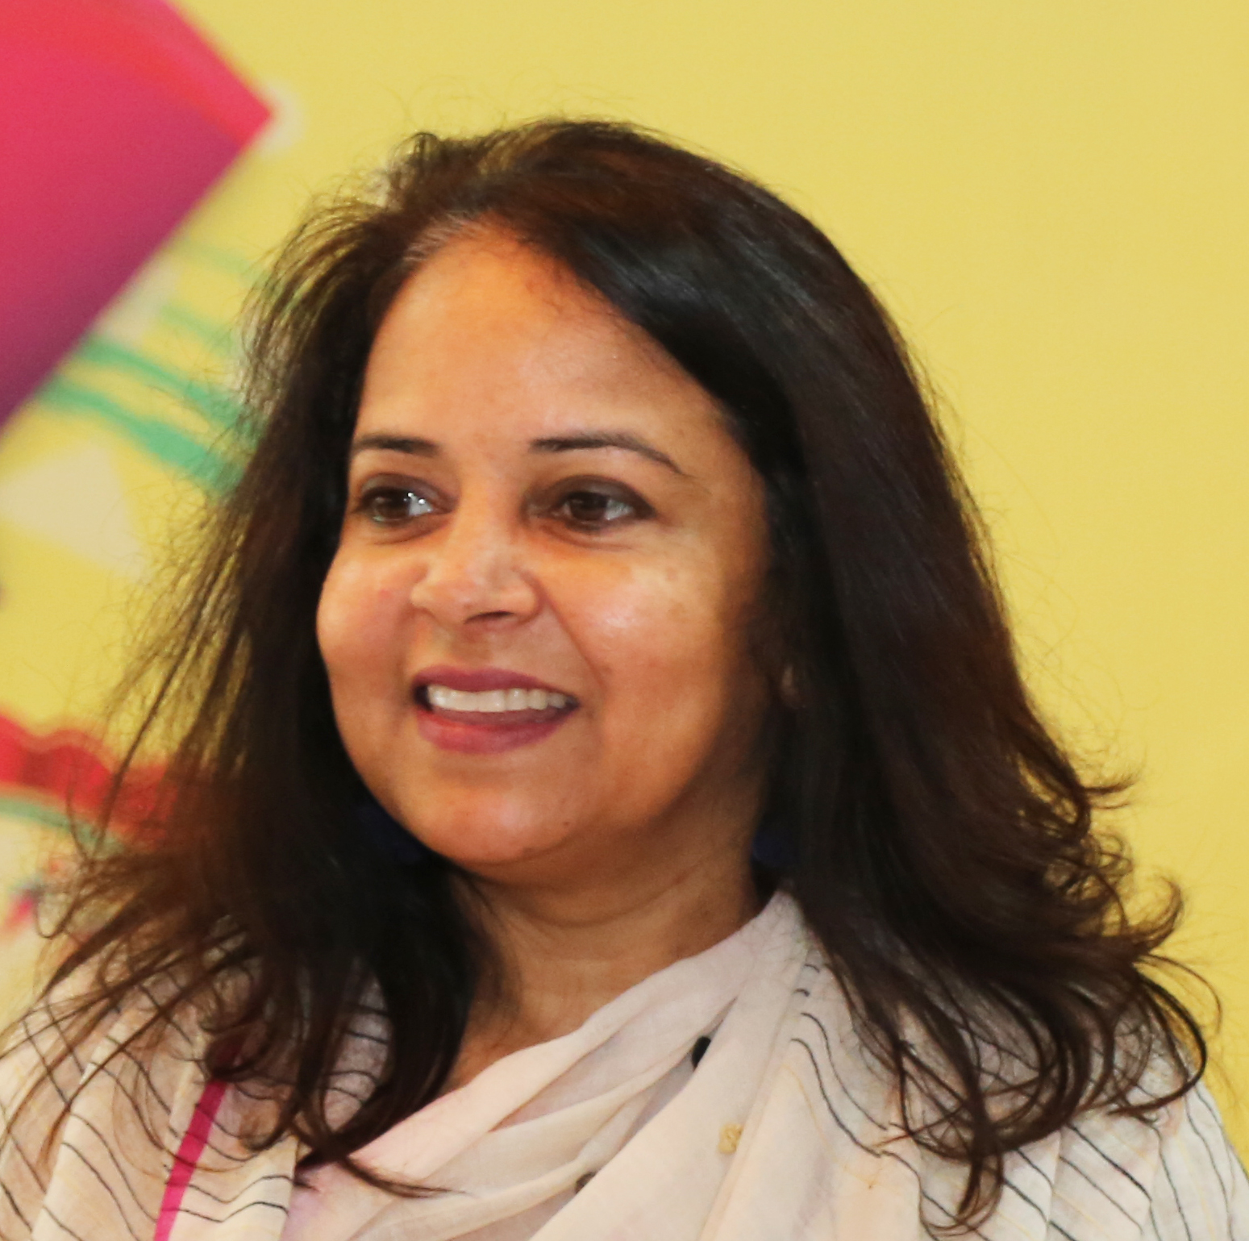
How can anthropological approaches inform COVID-19 research and interventions?
Experiences from Bangladesh
Sabina Faiz Rashid
BRAC James P Grant School of Public Health
BRAC University Bangladesh

Slide 25
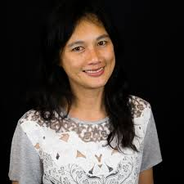
Q&A session

Slide 26
Thank you for joining our webinar!
Next webinar Circulation globale des idées et les effets sur le terrain en Afrique (26/6) & more to follow after the summer
Register to our Sonar-Global network: https://www.sonar-global.eu/join-sonar-global/
Join our discussions on COVID-19: https://www.sonar-global.eu/forum/sonar-global/

